Slide 1
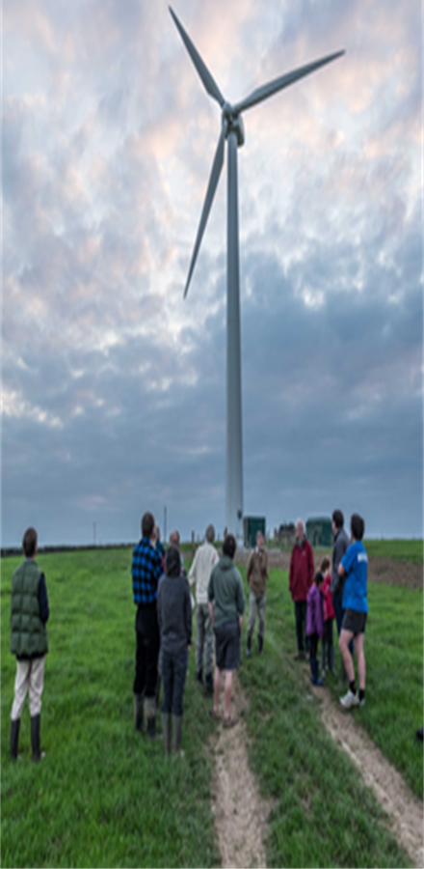
The Transition Bro Gwaun Community Climate Fund

Slide 2
Benefitting from income from the Abergwaun Community Wind Turbine
Income from the wind turbine funds community and business projects across North Pembrokeshire.
1
Current projects are extending the use of renewable energy, promoting biodiversity and sustainability.
2
The third round of grants for 2024 is underway.
3

Slide 3
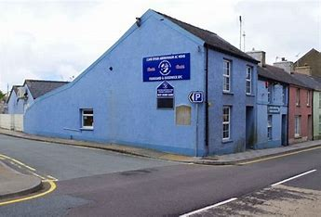
2023 Fishguard and Goodwick RFC
A battery storage system
is next on the shopping
list.
Come on ‘The Seagulls’!
Fishguard and Goodwick RFC has gone green with solar panels on the clubhouse roof.
TBG gave a grant of just over £8000 towards the panels.

Slide 4
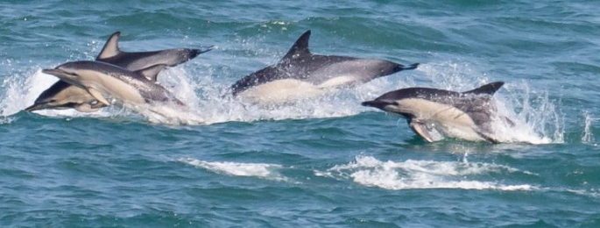
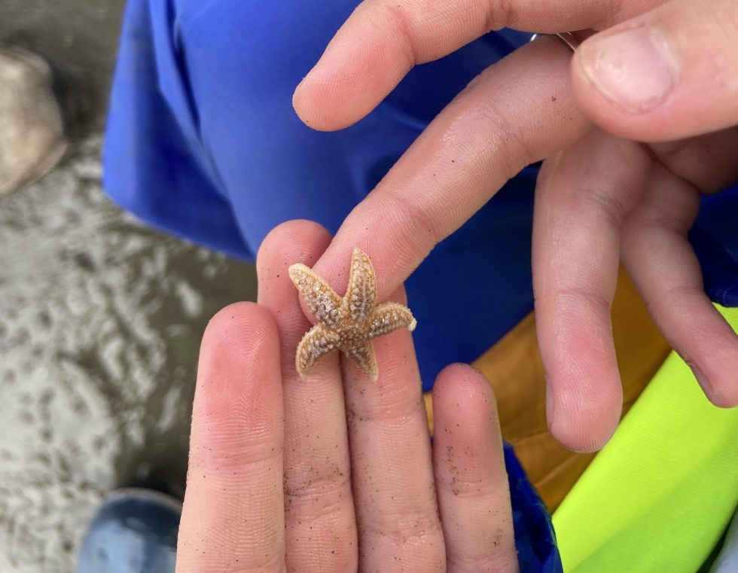
2023 A Greener Ocean Lab
Roof area for
solar panels
Sea Trust Wales is installing solar panels on the roof of the Ocean Lab to have a sustainable, low-cost energy supply.
TBG has given £10,000 towards the installation.

Slide 5
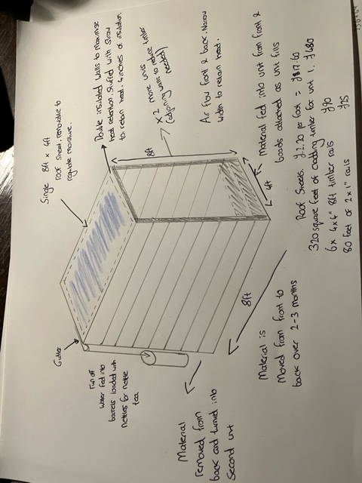
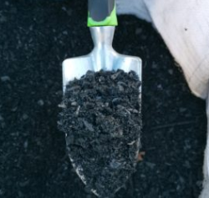
2023 Carbon Heart
Biochar and Composting
A grant from TBG was used to purchase biochar kilns and materials to construct peat free compost production units.

Slide 6
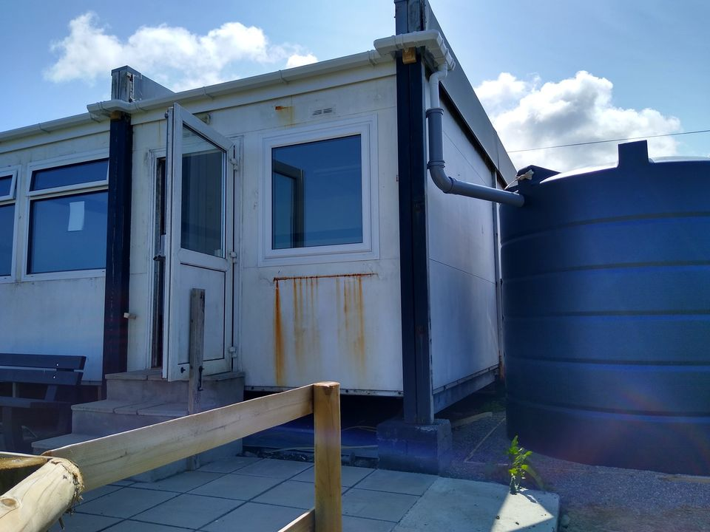
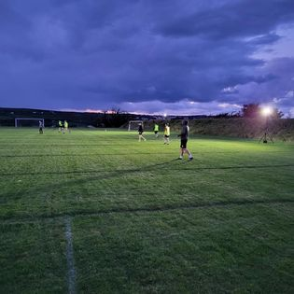
2023 Fishguard AFC
TBG made a grant to install a rainwater collection system.
The rainwater collection tank is in place, connections to the guttering have been made and rainwater collection is underway.
A new pump enables the club to draw the rainwater from the tank.

Slide 7
2023 Wyld Soul Kitchen
Kitchen equipment, including a hot composter, was purchased with a TBG grant to support this catering business which gained a Green Goal Award from the Welsh Government in December 2022 for demonstrating sustainability.

Slide 8
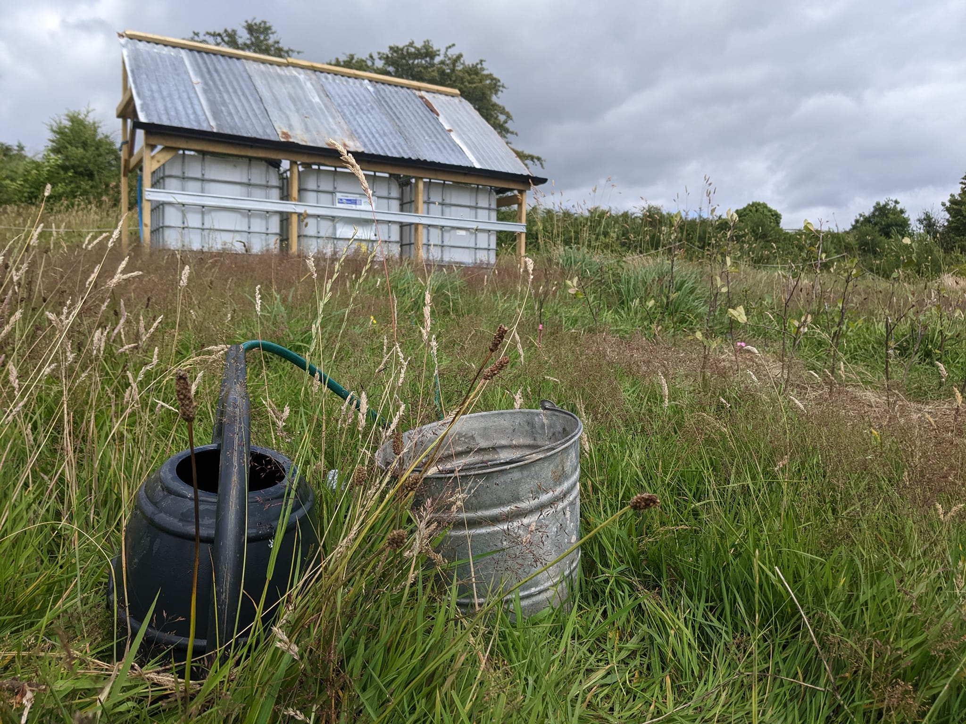
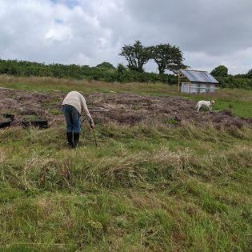
2023
Trees for Resilience
Trees for Resilience grows and sells resilient trees for a time of a changing climate.
A grant from TBG helped create a water capture system for Trees for Resilience.
They are watering land with a home-made indigenous microbe water solution. This will help to build a soil that is particularly well-suited to trees.

Slide 9
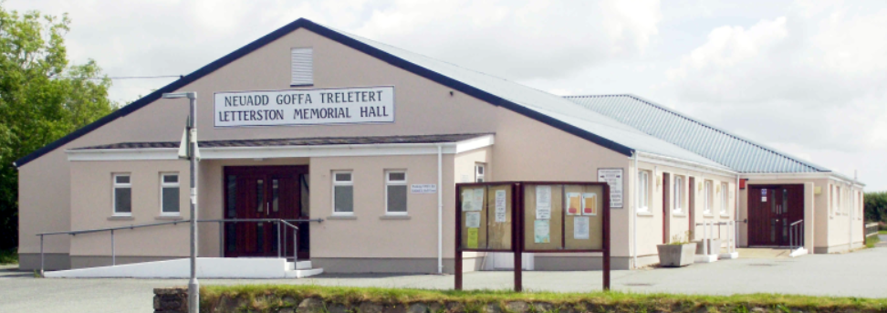
2023 Letterston Memorial Hall
A new air source heat pump was installed to replace the ageing bottled-gas-fired boiler heating system.
TBG gave a £7,5000 contribution to the new scheme.

Slide 10
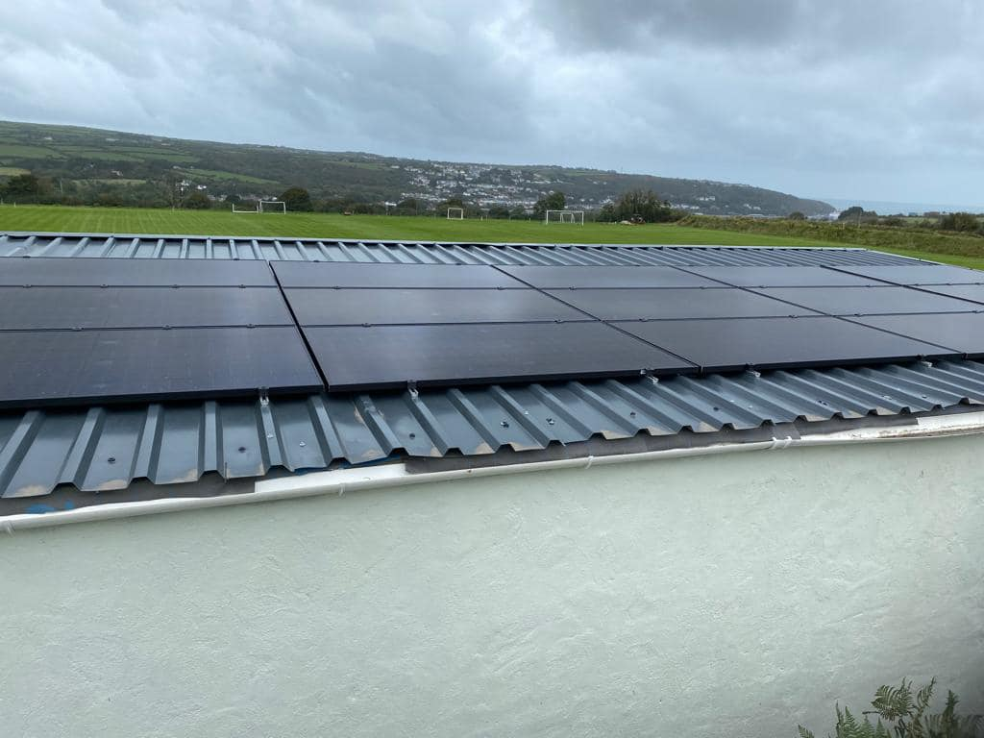
2022 Fishguard AFC
Roof mounted solar panels give a low cost, sustainable energy supply and some income from the feed in tariff.

Slide 11
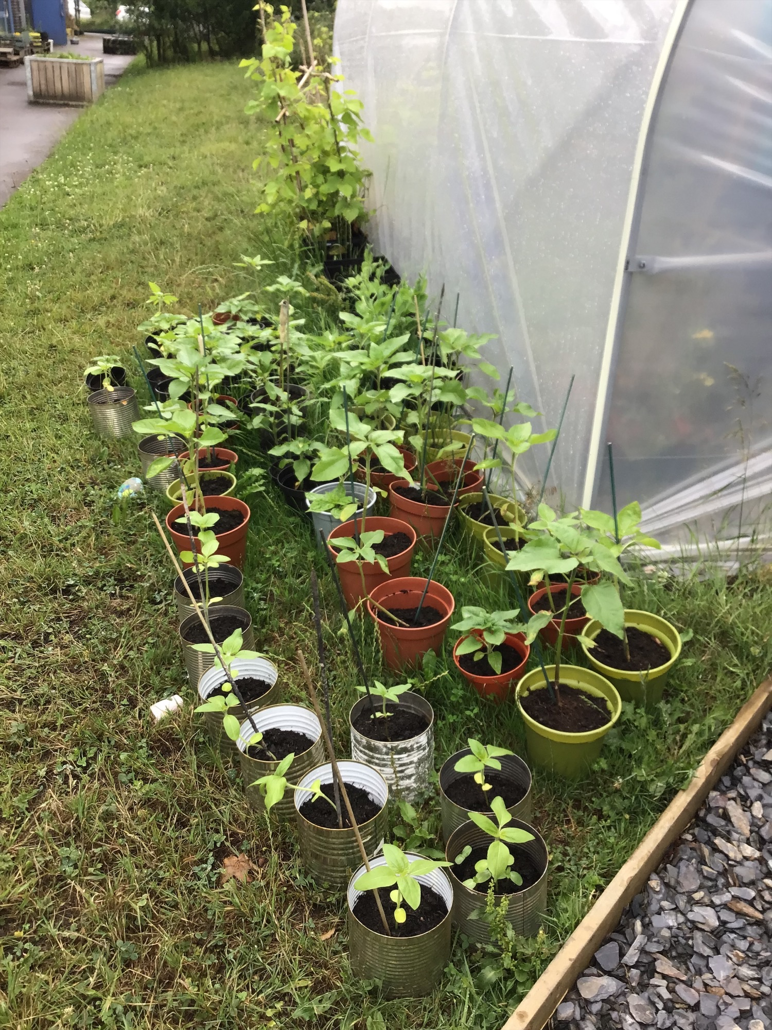
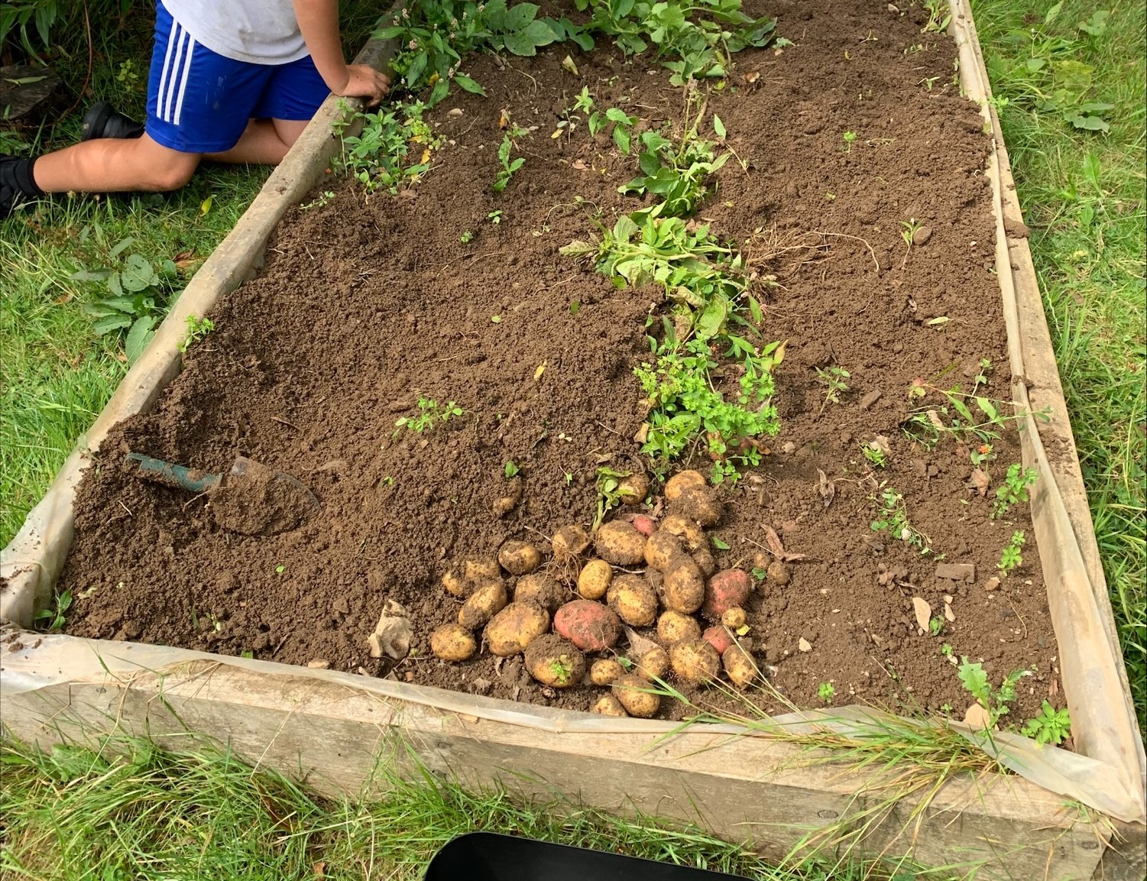
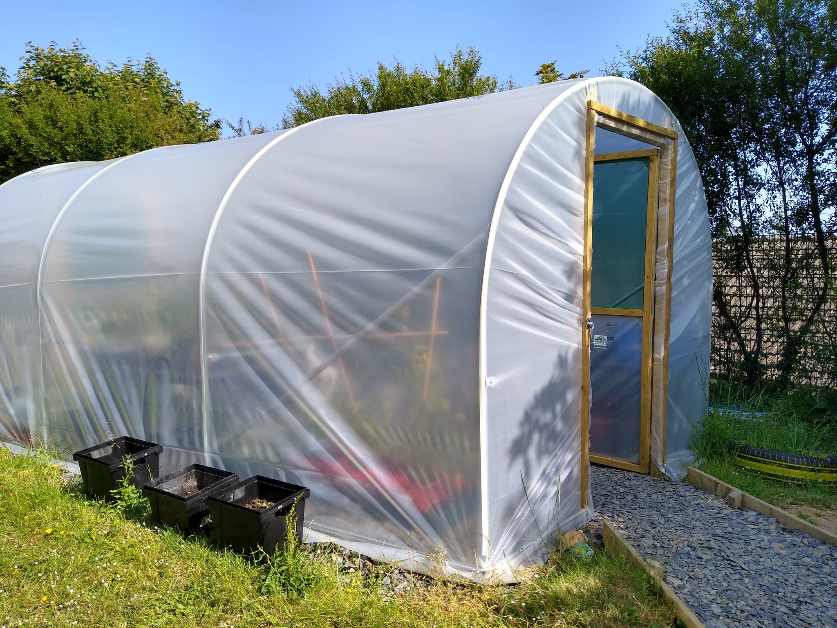
Add a Slid
2022 Sow, Grow and Eat
The school set up a polytunnel and now grows food for use in their cookery club as well as selling some.

Slide 12
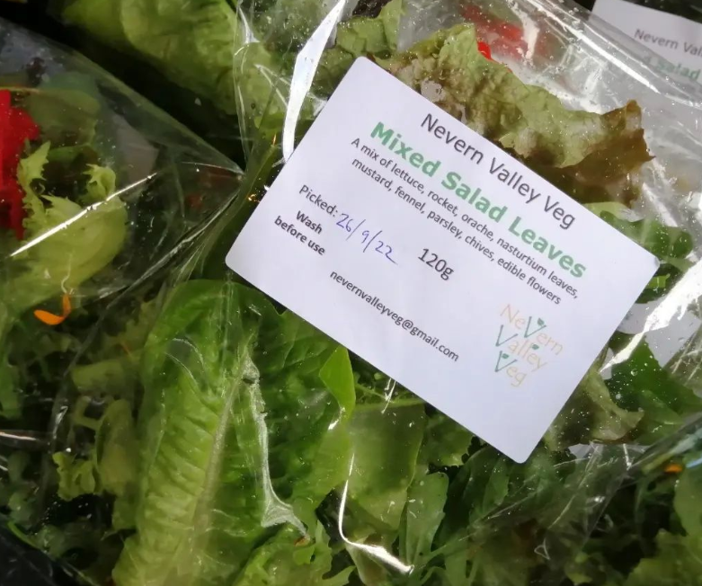
2022 Nevern Valley Veg Solar Irrigation
Solar powered pumps bring water to the Nevern Valley Veg plants

Slide 13
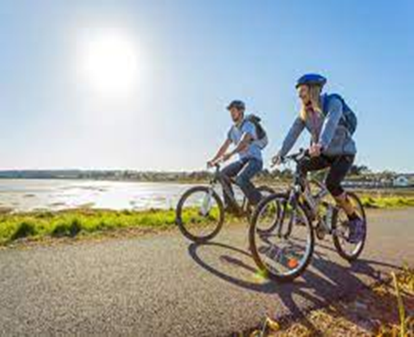
2022 St Dogmaels Llandudoch
6 cyclists were trained by Cardiff Cycle Workshop to lead bike rides and build people’s confidence to go on short ‘active travel’ journeys instead of going by car.
Ffrindiau Beic

Slide 14
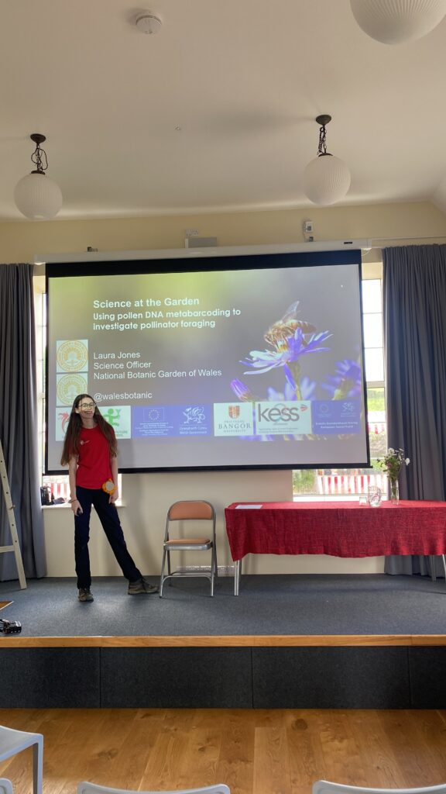
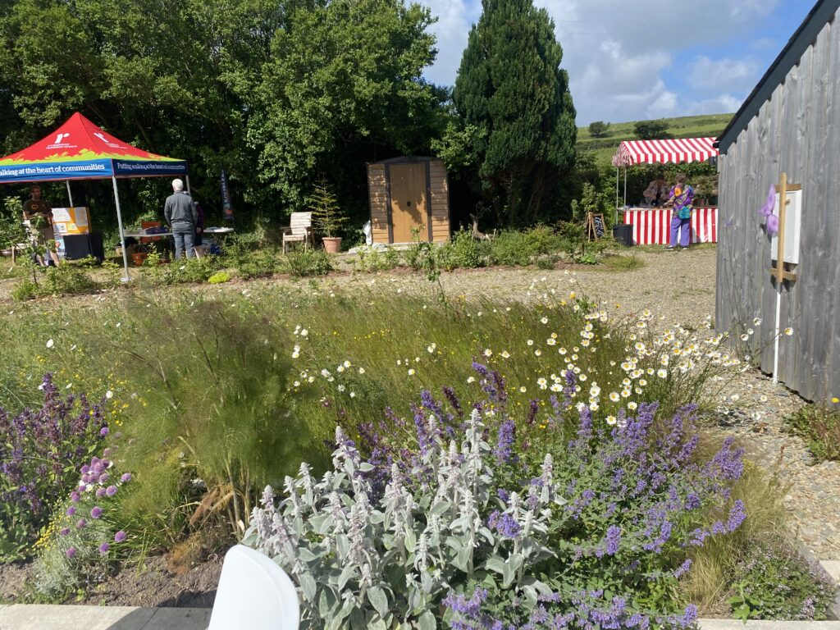
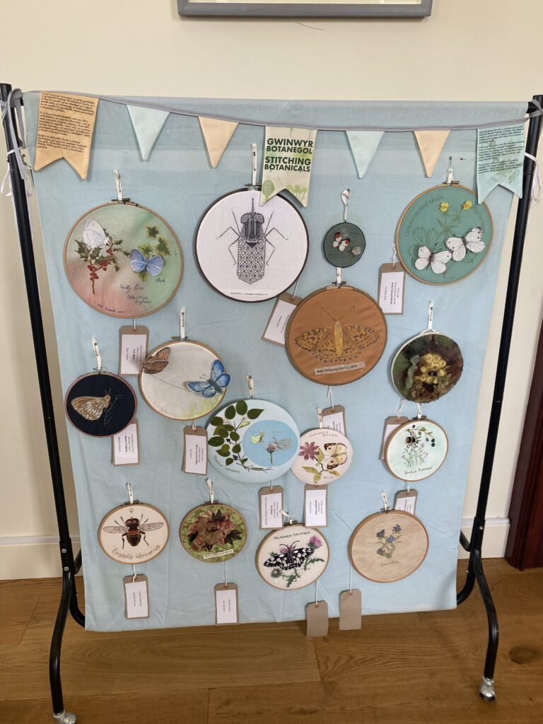
Brynberian Community Hall Pollinator Party in June 2022
Over 200 people attended, bringing positivity and enthusiasm for the Saving Pollinator Assurance Scheme

Slide 15
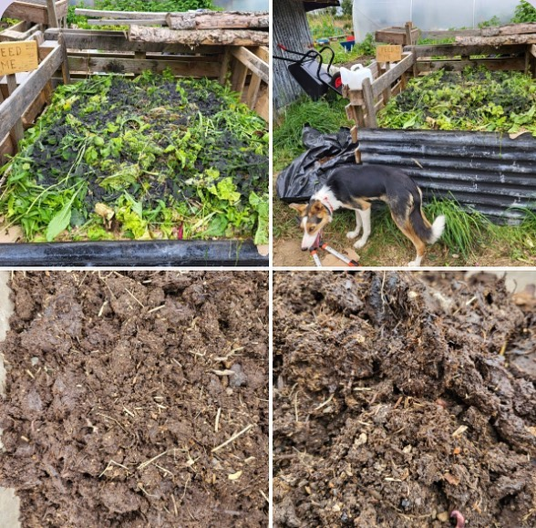
Delivery of educational sessions focussed on regenerative food production and preserving, and land management.
2022 Field of Beans
Community Garden
Blaenffos

